Slide 1
Develop Tips Hrtx Android Spring1-2
-Simsun

Slide 2
database
Insert
insertWithOnConflict
Bulkinert
insertHelper
Transaction

Slide 3
database
Cursor leak
Design cursor lifecycle
Pass cursor
DO NOT pass cursor
Cursor loader
TODO

Slide 4
database
Cursor leak
Design cursor lifecycle
Pass cursor
DO NOT pass cursor
Cursor loader
TODO

Slide 5
JNI
5.2 Freeing References
Each JNI reference consumes a certain amount of memory by itself, in addition to the memory taken by the referred object. As a JNI programmer, you should be aware of the number of references that your program will use at a given time. In particular, you should be aware of the upper bound of the number of local references your program can create at any point during its execution, even though these local references will eventually be freed automatically by the virtual machine. Excessive reference creation, however transient, can lead to memory exhaustion.

Slide 6
JNI
DeleteLocalRef
Delete every object when useless in Callback functionPass cursor
SetObjectField(dwi, jfID, env->NewStringUTF(szDateTime))
FindClass
NewString/
NewString
UTF/NewObjec
GetObjecField

Slide 7
JNI
while ( <condition> )
{
jobject myObj = (*env)->NewObject( env, clz, mid, NULL );
if ( NULL != myObj ) {
/* we know myObj is a valid local ref, so use it */
jclass myClazz = (*env)->GetObjectClass(env, myObj);
/* uses of myObj and myClazz, etc. but no new local refs */
/* Without the following calls, we would leak */
(*env)->DeleteLocalRef( env, myObj );
(*env)->DeleteLocalRef( env, myClazz );
}} /* end while */

Slide 8
JNI
Callback
JNI references are valid only in threads attached to a JVM
AttachCurrentThread
DetachCurrentThread()
Keep Everything RAII
A valid JNI global reference must be obtained from another valid JNI reference (global or local) by calling NewGlobalRef or NewWeakGlobalRef.

Slide 9
activity
onSaveInstance
Don’t keep activities (Developer option)
TabhostAcitivity
Deprecated
Fragment replace
Smooth PullRefreshListView
Touch mode = false
Rotation (API 11)
SnapShot (TODO)

Slide 10
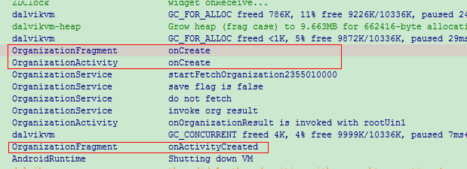
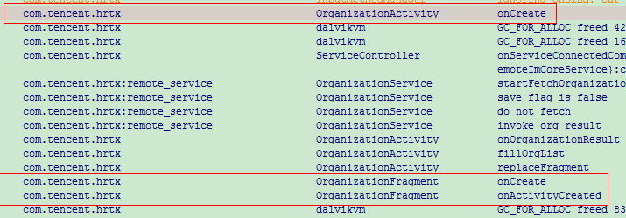
Relaunch Timing
Who use Who hold lifecycle

Slide 11
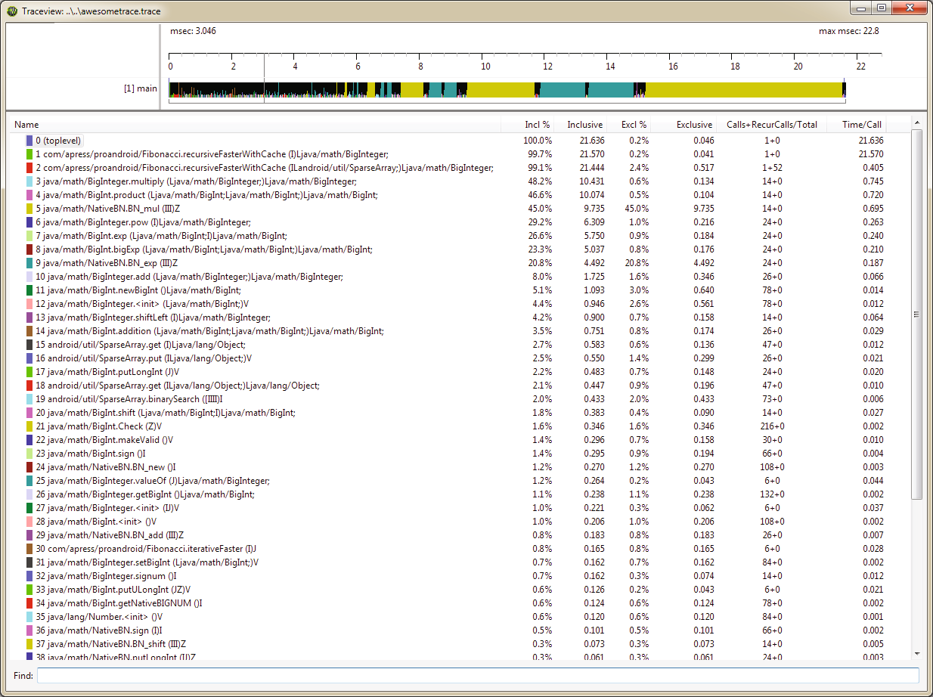
tools
Traceview

Slide 12
tools
StrictMode
Sql
Thread
Monkey Runner

Slide 13
TODO
Asychronize AIDL interface
Unit Test

Slide 14
Thank you & Let’s Talk

